Slide 1
Solar-PV Final Project
By: Stephanie Tarczynski, Tessa De Souza Machado, Ryan Littrell

Slide 2
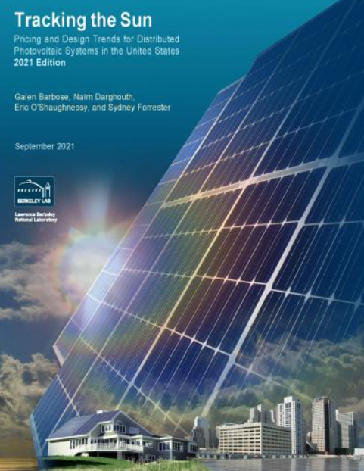
Introduction
This project is centered around the University of California-Berkeley “Tracking the Sun" project. This data set consists of over a two million data points of solar cell systems throughout the United States.
As a team, we parsed through the data to narrow down which columns have relevant information.
We decided to focus our project on investigating the locations of the solar modules and the corresponding efficiencies and costs. We chose these inputs because this information is important to the core users we identified: individual/large scale purchasers of solar cell systems and investors.
Key User Questions:
Which areas of the US have the highest module efficiencies and the lowest costs?
Which factors influence cost?
Which factors influence efficiency?
Notes:
Our project is centered around the university of california berkeley tracking the sun project. This project has tracked over 2 million solar systems installed throughout the US ( and their parameters and metrics) from large scale industrial solar farms to individual home owners. In order to focus on key questions and objectives this dataset had to be parsed down to a manageable amount of data. Cost and efficiency are two of the major factors purchasers, installers, and investors will look for in solar technology. The project and software we created aim to answer the the primary questions: which areas of the US are the best performing/lowest cost? And which factors influence the cost and efficiency?

Slide 3
Dataset
Berkeley Lab’s Tracking the Sun report (here): September 2021
Contains data for approximately 2.2 million solar PV systems in the U.S.
Parsed down data to mostly filled columns
Removed projects that did not report module efficiency
Notes:
Includes things like: system size, number of modules, capacity, and location
Parse down:
Removed datapoints that did not report efficiency since this is one of the most important factors. Many states did not report efficiency so they were not included in the analysis.
Removed columns that had mostly nan values -> not much value added (~ 20% of column had data)
This reduced our dataset to about 20% of the original dataset

Slide 4
Geographical Visualizations
Geocoding
Latitude and longitude of locations in the dataset needed to visualize the data: over 600,000 cities included
Geocoding performed through custom program and using GeoPy and the geolocating service Nominatim
Mapping with Folium:
Heat map of module density in the US
Choropleths related to cost and efficiency
Notes:
One feature we thought would be helpful especially to investors in solar cells is to create maps which can create a visual indicator of cost and efficiency in order to determine which areas might be best to invest in. Geographical visualizations were created in two steps:
Geocoding the locations: this involves taking the city and state info provided and using software to convert it into latitude and longitude coordinates to make it compatible with Folium
Mapping with folium: we have included a heat map which demonstrates the density of modules and choropleths which show the average efficiencies and cost in each state

Slide 5
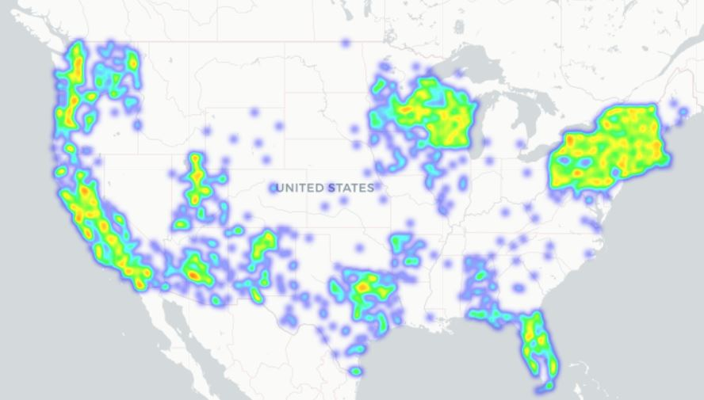
Heat Map of Module Locations
Notes:
High density in major cities
High density in particular regions: California, Phoenix, AZ, Northeast
Not necessarily a high density in the sunniest regions
Note that these are just the states that report efficiency data

Slide 6
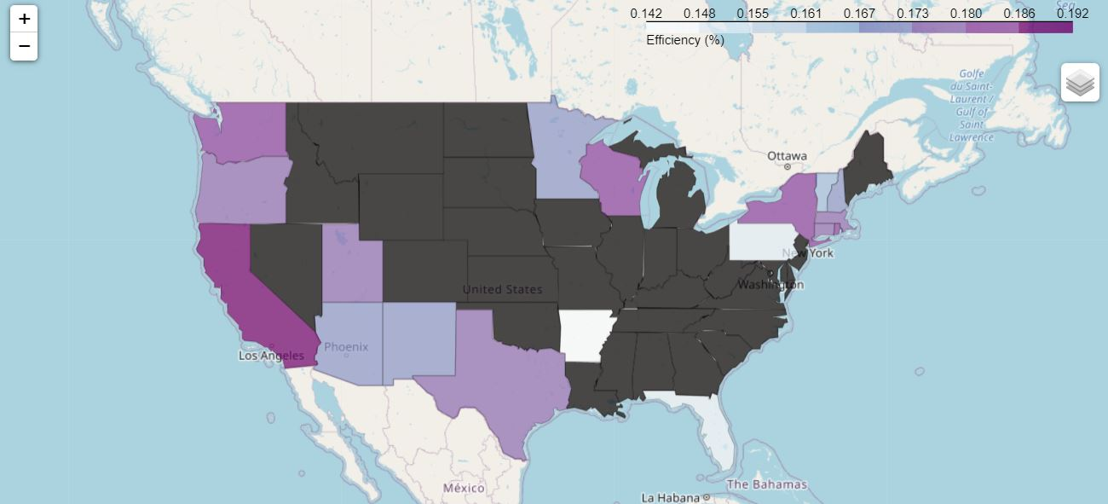
Average Efficiency per State
Notes:
Efficiencies range from ~ 0.14 - 0.19
California has the highest efficiency
Efficiency is not necessarily correlated with most modules or sun

Slide 7
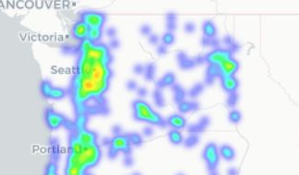
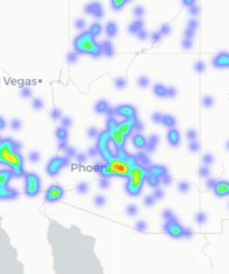
Efficiency vs. Density
The sunniest states do not necessarily have the best efficiency
Notes:
An interesting insight from the state efficiency choropleth is that the states with the best efficiency do not necessarily correlate to the sunniest states. Shown above, Washington has a higher efficiency than Arizona despite most of Washington’s modules being concentrated on the rainy side of the Cascades while Arizona’s are primarily concentrated around the Phoenix area. Many states on the East Coast also perform better than Arizona, New Mexico, and Texas.

Slide 8
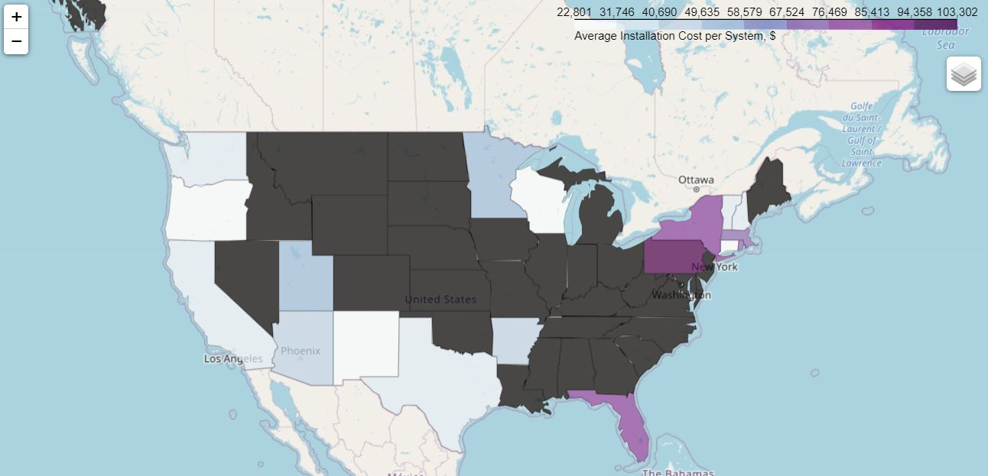
Average Cost per Module
Notes:
California has some of the highest efficiencies and lowest cost per modules but the market does seem saturated.
The West tends to have a lower installation cost than the East.
Pennsylvania has some of the lowest efficiencies and highest average installation costs.
Eastern Washington and Oregon which receive considerable more sun than west of the Cascades seem to be untapped markets having both lower costs and higher efficiencies.

Slide 9
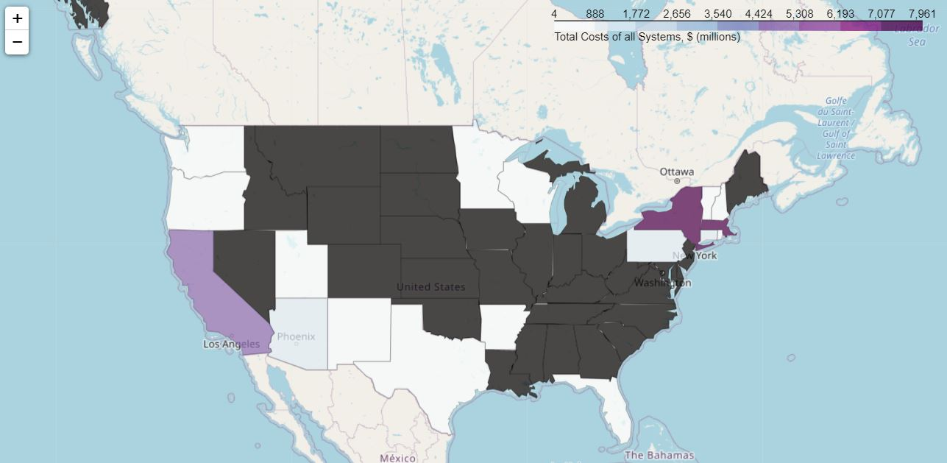
Total Cost for all Modules
Notes:
California, New York, and Massachusetts have invested several billions of dollars in solar cell technology. These states also have some of the best efficiencies.

Slide 10
Visualizations Insights
Modules are concentrated near major cities
States with the highest efficiencies are not necessarily the sunniest states
Sunnier states like Arizona and New Mexico have surprisingly lower efficiencies than many Pacific Northwest and Northeast states
California dominates in highest efficiency and lowest cost per module
California market also appears to be the most saturated
Eastern Washington and Oregon could be untapped markets
Pennsylvania has the lowest efficiency and highest costs

Slide 11
Efficiency Analysis
Simple visualizations with Statistical and Machine Learning analysis to investigate various factors that influence efficiency.
Nameplate Capacity was one central factor that is focused on, mainly because this is an input that clients can easily get from the manufacturer
California was identified through geocoding latitude and longitude as having unique output efficiency, and so there is some specific analysis done on that subset of data.

Slide 12
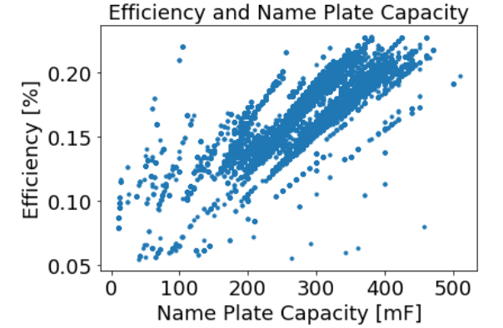
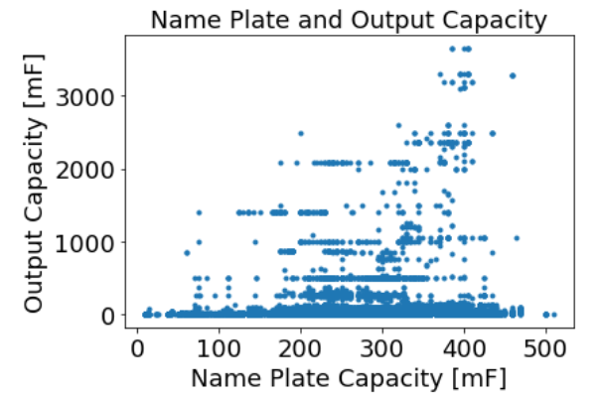
Simple Visualizations
Notes:
An easy way to see simple trends for the variety of factors. Nameplate cap is seen to have obvious trends. This is also after having removed all Nan and absent values

Slide 13
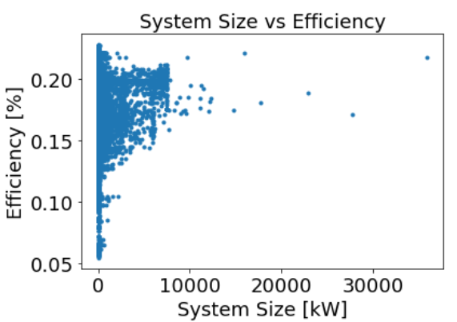
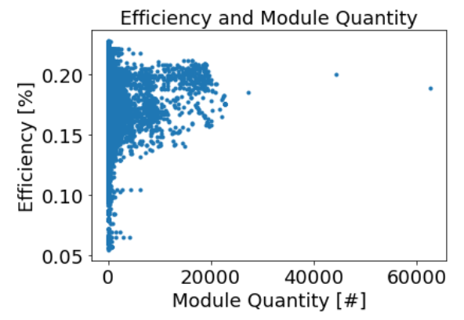
Notes:
More examples, with some similarities, but not very strong correlations.

Slide 14
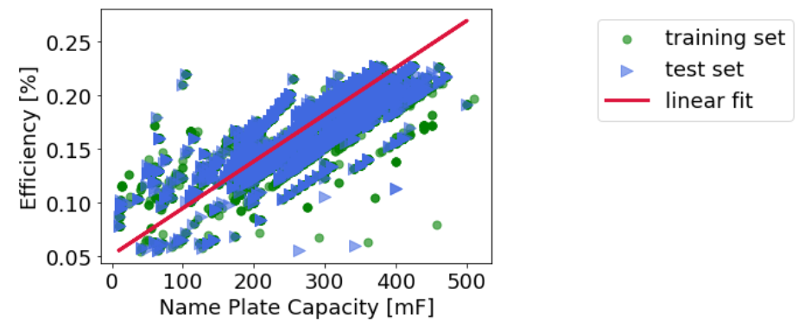
Linear Regression:
Mean squared error: 0.0001076953744925368
Coefficient of determination: 0.78
Decision Tree Regression:
r2 value: 0.8417592683646062
MSE Value : 7.630438754679849e-05
Selected input features using Backward Stepwise Selection for Efficiency:
['mod_BIPV1' 'mod_nameplate_capacity1' 'inverterQuantity_1'
'inv_microinv1' 'ILR']
Notes:
Linear regression model and decision tree with similar results, although decision tree was more accurate and reliable for this particular data set.
We can see how there are various trends that one could find, and by only choosing specific subsets of data, we could get very accurate trendlines.

Slide 15
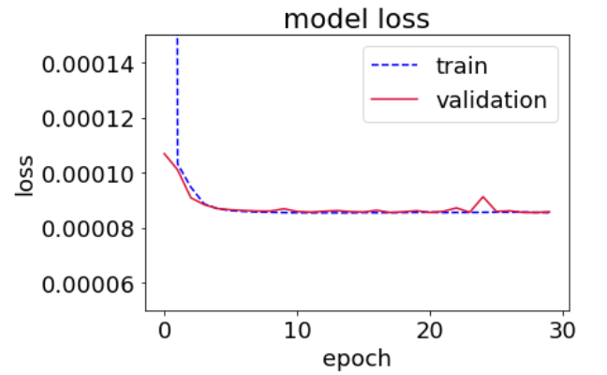
Neural Net Loss Model
Very little loss after the first epoch, this helps us know the validity of our training and testing data sets.
This model is centered around Efficiency and Name Plate Capacitance values.
Tensorflow and Keras used with a standardscaler to fit the trained data
Notes:
Could do NN on a collection of factors, could use efficiency NN to predict efficiencies of states that we didn’t include.
Using Keras and Tensorflow and a standard scaler to fit the trained data.

Slide 16
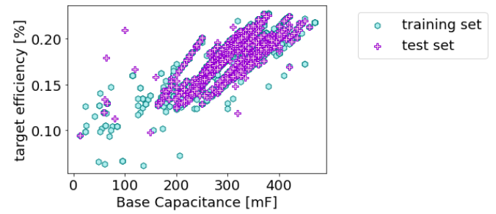
California sub-data set
r2 score: 0.7303818723705231 MSE: 8.731303155648702e-05
K-Fold-5 Cross Validation number: 0.00011622859545276414
Notes:
We see similar visual and statistical correlations as the main data set, seeing as how a lot of data points were from Cali.
K fold CV is based on 5 folds of the data set, showing very little variability in MSE values.

Slide 17
Cost Analysis
Feature selection was used to determine the most important attributes that contributed to the total installation cost
A heatmap was used to assess correlation between other features in the dataset as well
Using the found features, regression models were used to determine the fit
Similar model was done on California

Slide 18
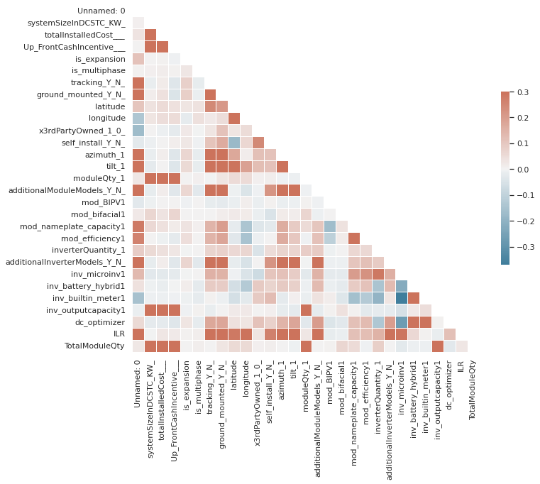
Heatmap of Complete Dataset
Notes:
Heatmap of whole

Slide 19
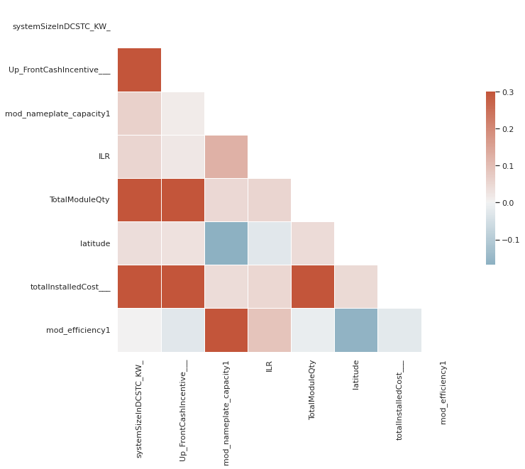

Feature Selection
Heatmap
Forward/Backward Stepwise Selection

Slide 20
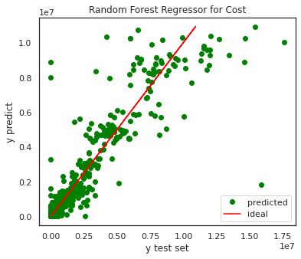

Random Forest Regressor
Features:
System size
Up front cash incentive
Nameplate capacity
Inverter Load Ratio
Total module quantity
Latitude
Efficiency
Total installation cost

Slide 21
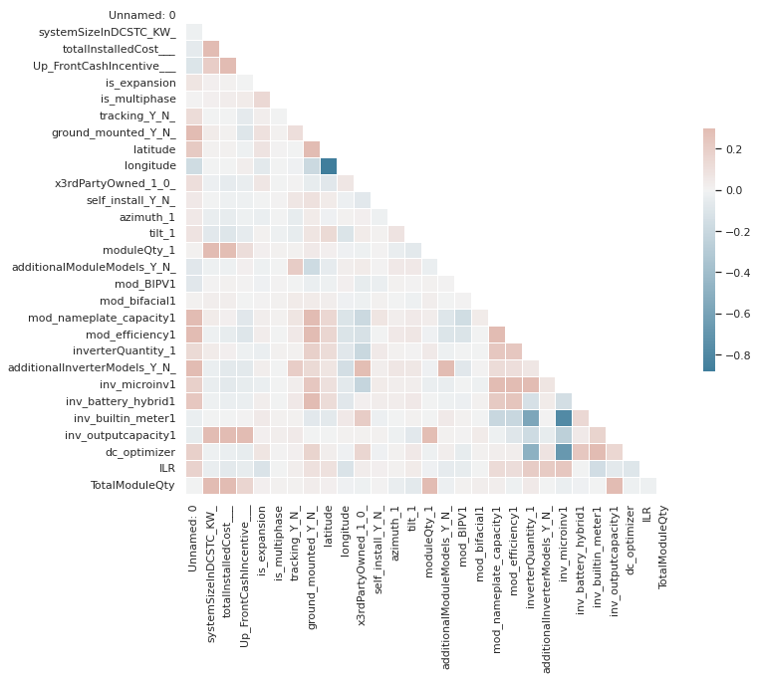
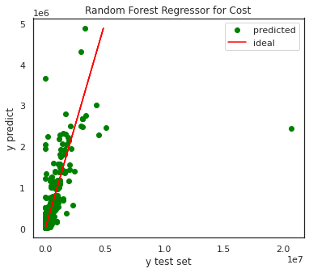

California: Heatmap
California data
No strong correlation with other features
Cost has little influence on the high efficiencies found for California

Slide 22
Conclusion
Geographical maps help illustrate the variance of efficiencies with latitude and longitude, and how cost seems to be related with saturation of the market in specific states.
The base technology dictates the nameplate capacitance which is central for figuring out resulting efficiencies. Location has some impact, but not nearly as much as the technology.
Cost is mostly correlated with the technology used and number of modules. This is useful for purchasers, but it also depends on the local market.
This massive data set could be broken into many more subplots to be analyzed, whether focusing on specific geographical areas or more quantitative factors.

